Slide 1
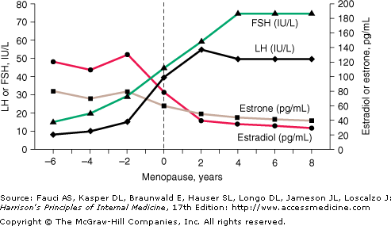
Menopause
Menopause: A time in a woman's life when her periods (menstruation) eventually stop and the body goes through changes that no longer allow her to get pregnant
Age: 45 – 55
Pathophysiology: a woman's ovaries stop making eggs and they produce less estrogen and progesterone. Changes in these hormones cause menopause symptoms. Periods occur less often and eventually stop. Sometimes this happens suddenly. But most of the time, periods slowly stop over time.
Did you know? Smokers hit menopause 2 years earlier than the average female
 | Before menopause | After menopause
Estradiol | High | Low
Estrone | High | Low
FSH | Low | HIGH > 40 IU/L
LH | Low | high
Notes:
FSH and LH become high menopause b/c hormone tries to make increase follicles of ovulation to produce more estrogen

Slide 2
Time
Perimenopause
Transition
Menopause
Age 50
Postmenopause
Age 51
Last period
1 year w/o period
no period
5 years MAX of HRT
To decrease risk of Breast CA.
It is recommended to discontinue HRT within 5 years of initiation in order to decrease the risks of adverse effects, particularly breast cancer.
There is some evidence that HRT may have less cardiovascular risk when started in younger post-menopausal women, specifically before 5 years post-menopause
d/c HRT
b/c increase CV risk

Slide 3
Stages of Menopause
Early Phase of Menopause:
Age: 47
Menstrual Cycle is irregular (length > 7 days)
Symptoms: Abnormal bleeding
Late Phase of Menopause:
Age: ?
Amenorrhea: Menstrual Cycle is skipped
Late phase Symptoms:
Menstrual Periods that decrease in frequency
Vasomotor
Hot Flashes/flushes: sudden feelings of warmth, which are usually most intense over the face, neck and chest
Night Sweats: As a result of hot flashes
Genitourinary
Vaginal Dryness
Dyspareunia
Cognitive
Sleep Disturbances
mood changes

Slide 4
POSTmenopause
Postmenopause: all of the time that follows the point when her ovaries become inactive.
How to know when it happens?
12 months after final menstrual period (FMP)
Age: 51
Pathophysiology: FSH levels will rise as ovaries begin to shut down, having 0 Estrogen and Progestin; these levels are easily checked through one blood test.
Early state of Menopause
Symptoms: Same as menopausal symptoms
Vasomotor: Hot flashes and night sweats
genitourinary

Slide 5
Menopause
Lifestyle Change
Stop smoking
Decrease OH
Exercise
Avoid caffeine & spice
If Vasomotor Symptoms
Hot Flashes
Night Sweats
then
If Urogenital Symptoms
Contraindications?
If false then
Contraindications?
w/o Uterus
Uterus intact
Vaginal Cream
HRT
Estrogen
HRT
Estrogen
&
Progestin
Adding the progestin to the estrogen protects the lining of the uterus (the endometrium) from the harmful effects of estrogen
Notes:
HRT = Hormone Replacement Therapy
ET = Estrogen Therapy
EPT = Progestin Therapy

Slide 6
Contraindications to HRT
Absolute
1. Pregnancy
CV
2. History of DVT, PE
3. CAD or stroke
Cancer
4. Breast Cancer
5. Endometrial Cancer
6. Liver disease
7. Undiagnosed Vaginal Bleeding
Relative
Migraine HA
Seizure
Gallbladder disease
Hypertriglyceridemia
Uterine Leiomyoma
Condition | Estrogen | Progestin
Osteo | Good | Good?
Decrease LDL |  | Good
Colorectal Cancer |  | Good
DVT/PE | Bad | BAD
Stroke | BAD | bad
Breast CA |  | Bad
MI |  | bad

Slide 7
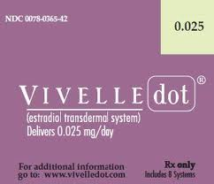
Estrogen Individual Agents
Use if patient has no uterus
Drug | Brand | Dose
Conjugated Equine Estrogens | PO: Premarin | 0.3 mg 1T PO daily 0.5 g cream daily
Synthetic Conjugated Estrogens |  | 0.3 mg 1T PO
Micronized Estradiol | PO: Estrace | 0.5 mg 1T PO
Estradiol Acetate | PO: Femtrace Vag: Femring | 0.45 mg 1T PO 0.05 mg q90d
Estropipate | PO: Ortho-Est | 0.625 mg 1T PO 1.25 mg 1T PO 2.5 mg 1T PO
17 β Estradiol | Patch: Vivelle Topical Gel: Estrogel Topical Emulsion: Estrasorb Vag Cream: Estrace Ring: Estring | Patch: 0.014 mg qd Gel: 1 packet qd Emulsion: 2 pk qd Cream: initial: 2 g qd maintain: 1 g 2week Ring: 2 mg ring q90d
Estradiol Hemihydrate tab | Vag: Vagifem
Route comments
PO start at 0.3 mg avoid in liver disease increase DVT/PE Breast tenderness Decrease LDL Transdermal Don’t put on breast No effect on lipids Osteoporosis Vaginal vaginal symptoms only 7 – 10 days
Notes:
Conjugated estrogen premarin
Micronized estradiol estrace micro = es’ trace
17 beta estradiol estrace
Estradiol acetate femtrace/femring estradiol ACEtate = femtrACE
Estropipate ortho EST ESTrOpipate = Ortho EST
17 beta estradiol vivelle alive to be 17
FemTrace (estrogen) Vs FemHRT (EE+norenthindrone)

Slide 8
Estrogen Individual Agents
Use if patient has no uterus
Route | Adverse Effects | Solve
All | Breast Tenderness Heavy Bleeding
Oral Estrogens
Transdermal Estrogens
Vaginal Estrogens

Slide 9
EPT = Estrogen + Progestin
Continuous Cyclic (“Sequential”) : most common
Estrogen Continuously: everyday
Progestin Sequentially : Given 12 days/month
Pros: Can predict the bleeding (last dose of progestin that day)
Cons: 80% of women have bleeding every month
Patient will have monthly bleeding when the progestin cycle ends
Continuous Long Cycle
Estrogen Continuously: everyday
Progestin: given 12 days EVERY OTHER MONTH
Pros: Bleeding every other month (no progestin = no bleeding that month)
Cons: not sure if it protects the endometrium
Continuous Combined
Estrogen Continuously: everyday
Progestin Continuously: everyday
Pros: Lower progestin dose than Continuous Cyclic
Cons: use in patients 2 years Postmenopause due to unpredictable bleeding
continuous progestin is linked to adverse breast outcomes
Intermittent-combined HRT
Estrogen: everyday
Progestin: take 3 days, off 3 days
Pros: lowest dose of progestin
Cons: unclear if this method protects endometrium
Notes:
Premarin: Estrogen only conjugated estradiol
Premphase continuous cyclic conjugated estradiol + medroxyprogesterone
Prempro continuous combo conjugated estradiol + medroxyprogesterone

Slide 10
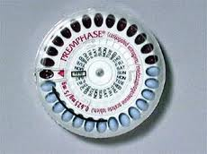
EPT = Estrogen + Progestin
Continuous Cyclic
Estrogen daily
Progestin 14d/month
Drug | Brand | Dose
Conjugated Estrogen (CEE) + Medroxyprogesterone (MPA) | Premphase | CEE 0.625 mg for 28 days MPA 5 mg last 14 days
Notes:
Cyclic. It’s just a phase conjugated estrogen + medroxyprogesterone
conjugated = it’s just a phase
medroxy = me drop the phase

Slide 11
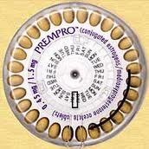
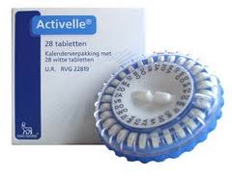
EPT = Estrogen + Progestin
Continuous Combined
Estrogen daily
Progestin daily
Drug | Brand | Dose (1/2 of cyclic b/c ½ the days)
Conjugated Estrogen (CEE) + Medroxyprogesterone (MPA) | Prempro Premarin + proges | CEE 0.3 mg PO daily & MPA 1.5 mg
Ethinyl Estradiol (E)& Norethindrone Acetate (P) | FemHRT EE + nor | E 2.5 mcg PO daily & P 0.5 mg
17β-estradiol (E) & drospirenone (P) | Angeliq 17 + leak | E 1 mg PO daily & P 0.5 mg
17β-estradiol (E) & Norethindrone acetate (P) | Activella 17? No | E 0.5 mg PO daily & P 0.1 mg
17β-estradiol & norethindrone acetate patch Patch decreases side effects such as breast tenderness | Combipatch 17? No | 0.05 mg estradiol & Norethindrone Twice a week
17β-estradiol & levonorgestrel patch Patch decreases side effects such as breast tenderness | CLimara Pro | 0.045 mg estradiol & Levonorgestrel Once a week
Notes:
premPRO continuous conj EE + medroxypro
Femhrt female = EE + Hurt = norethindrone
Activella active at 17? Nor…
Angeliq angel at 17 + Liq = spironoLactone

Slide 12
EPT = Estrogen + Progestin
Progestin individual agents (combine with Estrogen)
Drug | Brand | Dose
Medroxyprogesterone (MPA) | Provera | Cyclic: 5 mg Continuous: 2.5 mg daily
Norethindrone Acetate | Aygestin | Cyclic: 5 mg daily Continuous: 2.5 mg daily
Progesterone | Prometrium | Cyclic: 200 mg Continuous: 100 mg
Levonorgestrel | Mirena
Progesterone gel | Prochieve

Slide 13
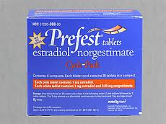
EPT = Estrogen + Progestin
Intermittent-Combined
Estrogen daily
Progestin take 3 days, off 3 days
Drug | Brand | Dose
17β-estradiol (E) + Norgestimate (P) | Prefest | 1 mg E + 0.09 mg P Take combined for 3 days Take E for 3 days
Notes:
Past 6 months
No

